Slide 1
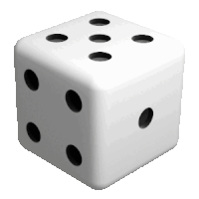

Monte Carlo Methods for Estimating Expectations and Gradients of Expectations in Reinforcement Learning
2/10/2025

Slide 2

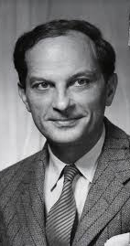
Monte Carlo method
Invented by John von Neumann and Stanislaw Ulam during WII for solving neutron transport in materials
Basic idea goes back to Buffon and Laplace (1749-1827)
Key idea:
estimate deterministic quantities such as definite integrals that are hard to compute exactly
by repeated random sampling

Slide 3
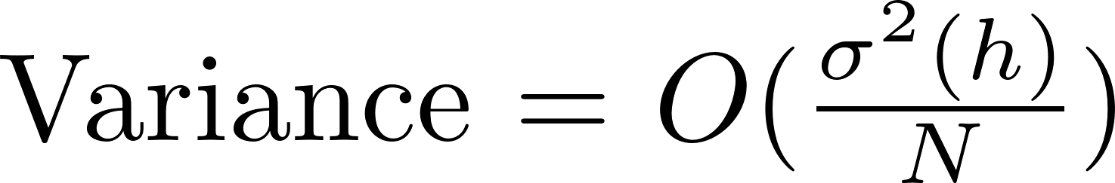
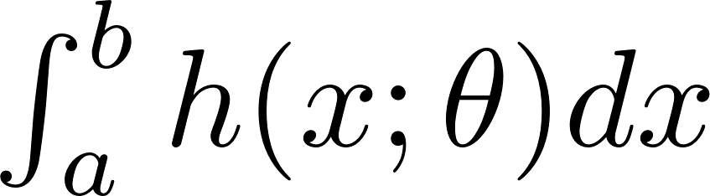
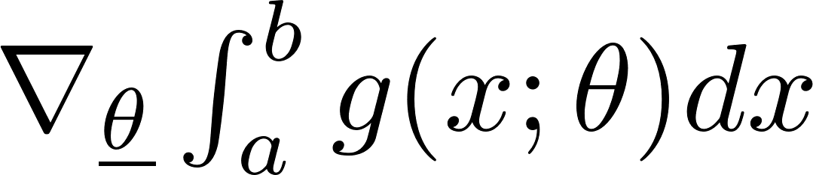
Organization
Control
variates
Importance
sampling
Sample efficiency
by reducing variance
Unbiased
Monte Carlo integration w/ uniform sampling
Numerical integration:
forward-Euler, Simpson, ……
Estimation
Curse of dimensionality
Expectations
Log-derivative trick
Gradients of
expectations
Need
ML/RL

Slide 4
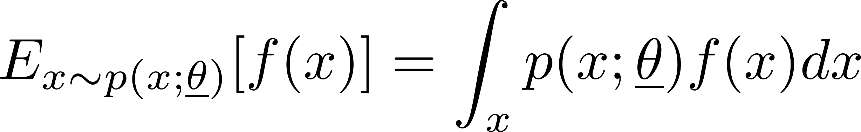
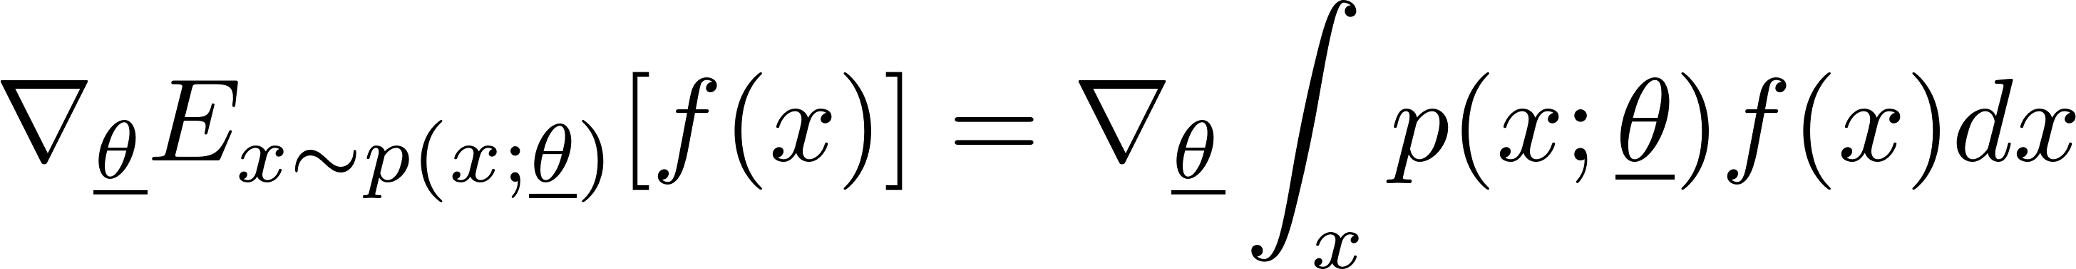
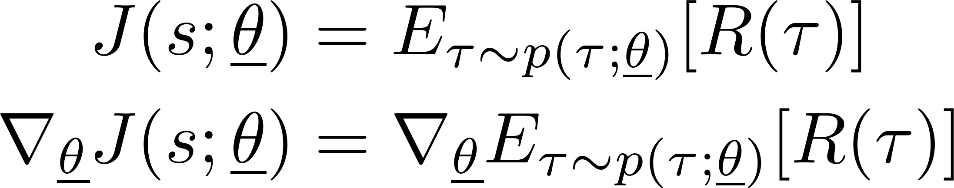
Expectations and gradients of expectations
action
distribution
θ
π_{θ}(A|S)
state (S)
DNN
Sampler
action
Deep RL Policy Network
Expectations are definite integrals
θ is a vector of parameters
Evaluate definite integral for fixed parameter values
Example: policy evaluation
Gradients of expectations
How does expectation change when θ is changed?
Gradient of expectation is not an expectation
Example: policy improvement
τ
s

Slide 5
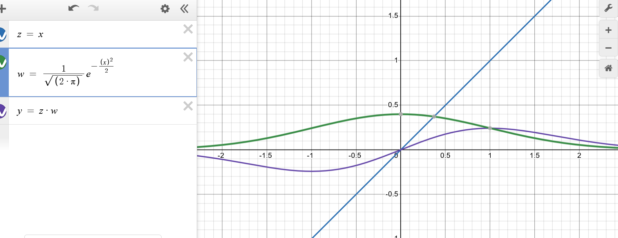
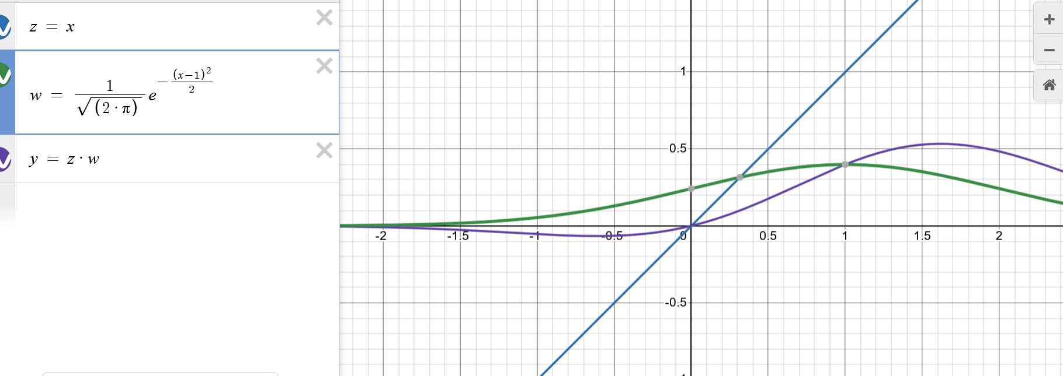
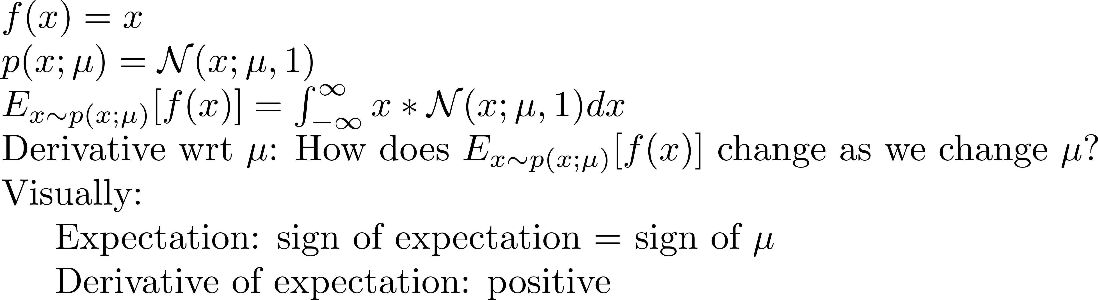
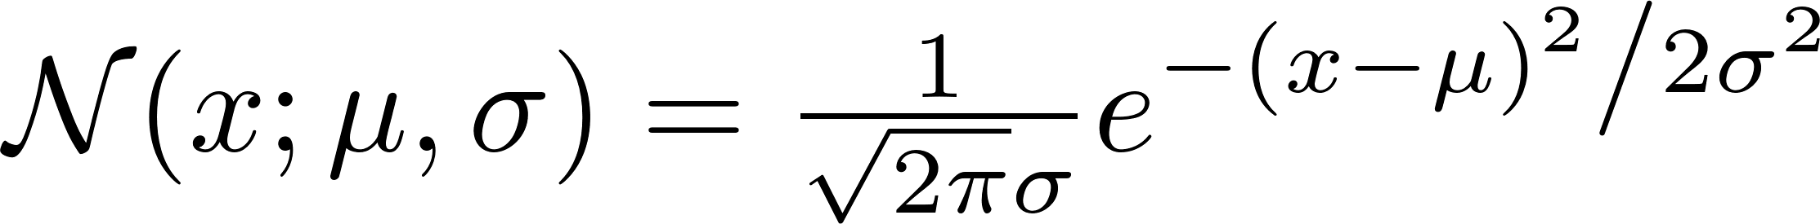
Example

Slide 6
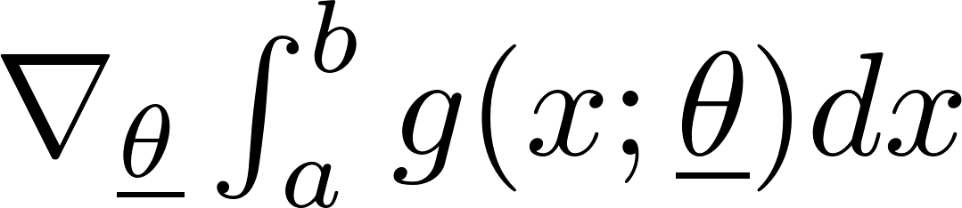
Organization
Control
variates
Importance
sampling
Sample efficiency
by reducing variance
Unbiased
Monte Carlo integration w/ uniform sampling
Numerical integration:
forward-Euler, Simpson, ……
Estimation
Curse of dimensionality
Expectations
Log-derivative trick
Gradients of
expectations
Need
ML/RL

Slide 7
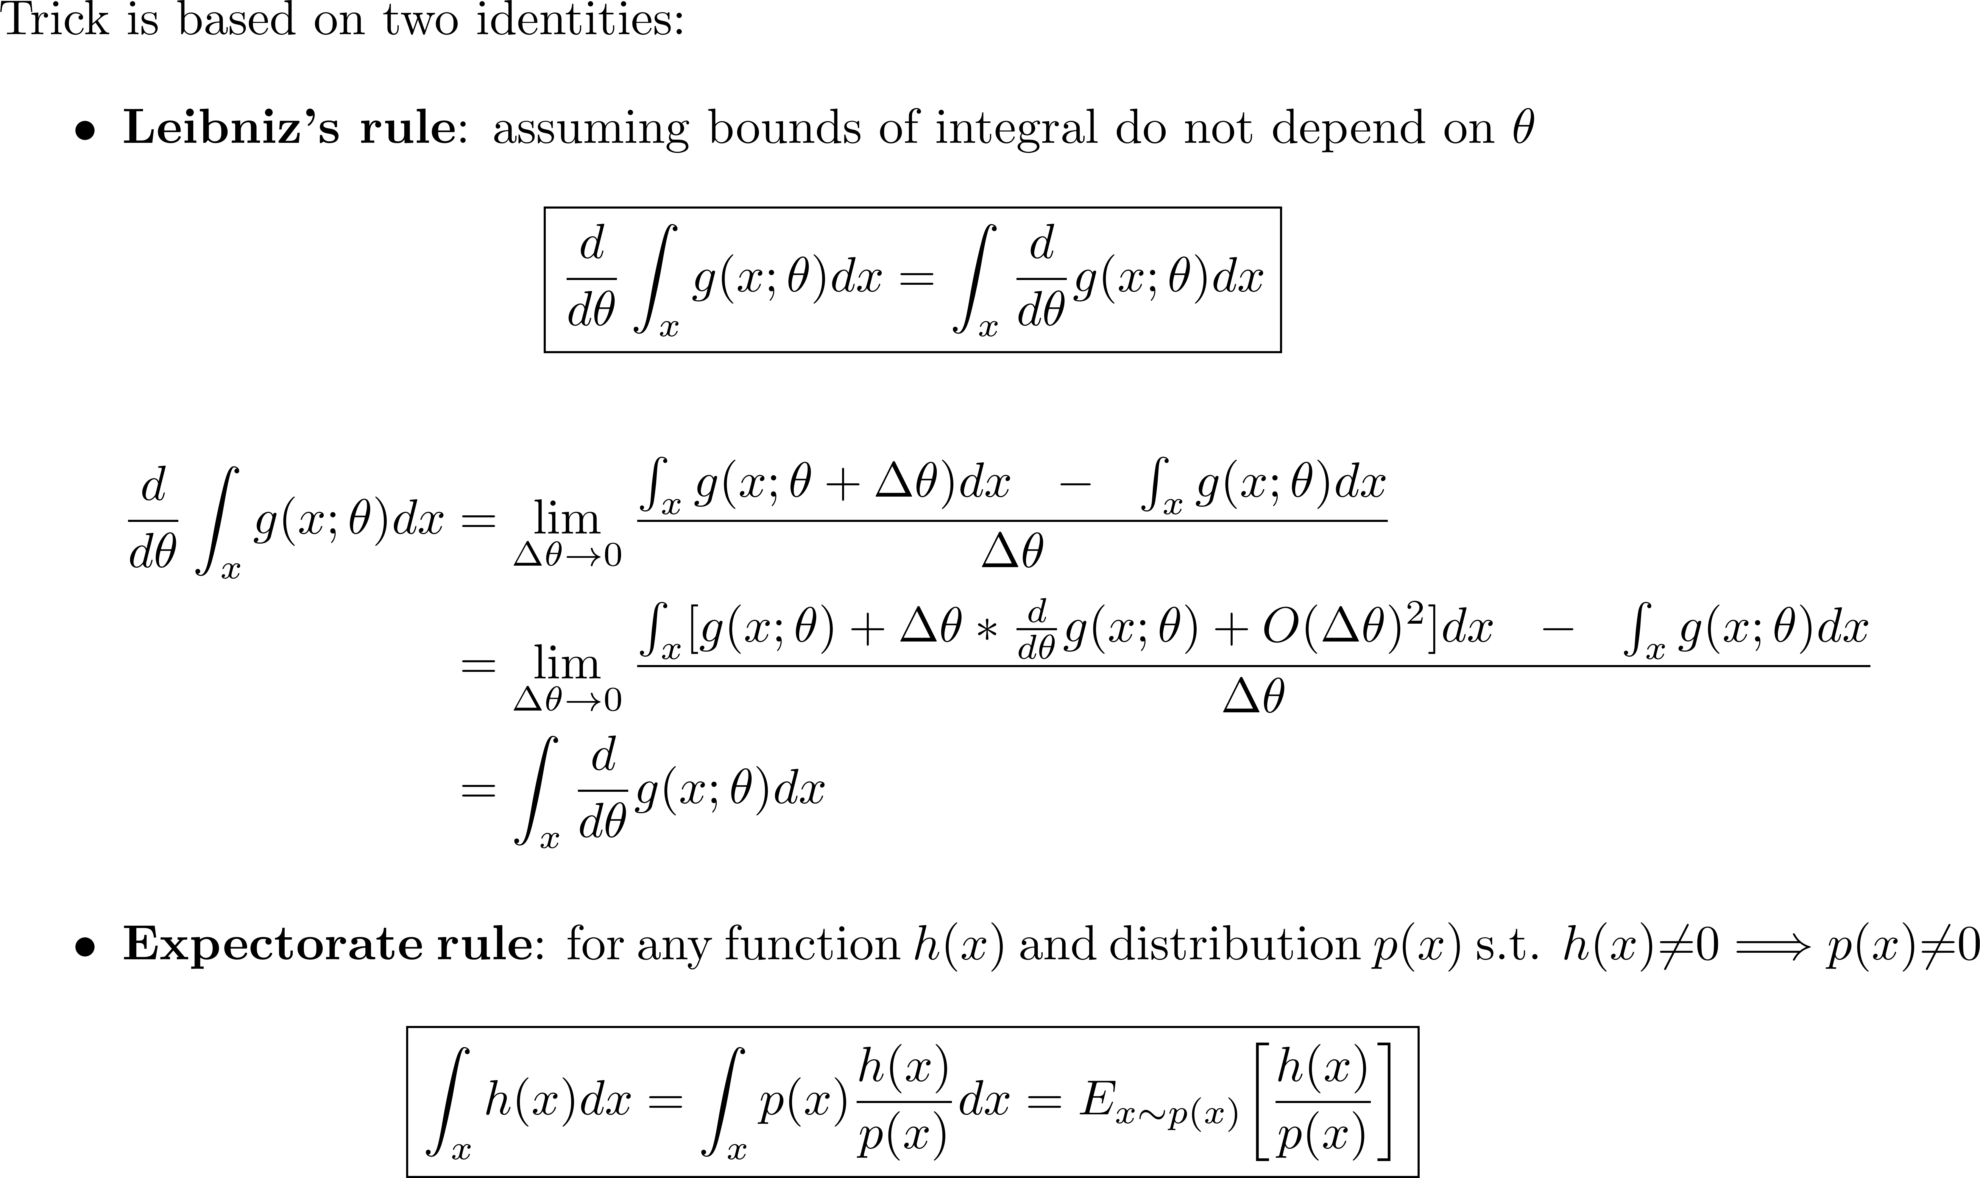
Log-derivative trick (I)

Slide 8
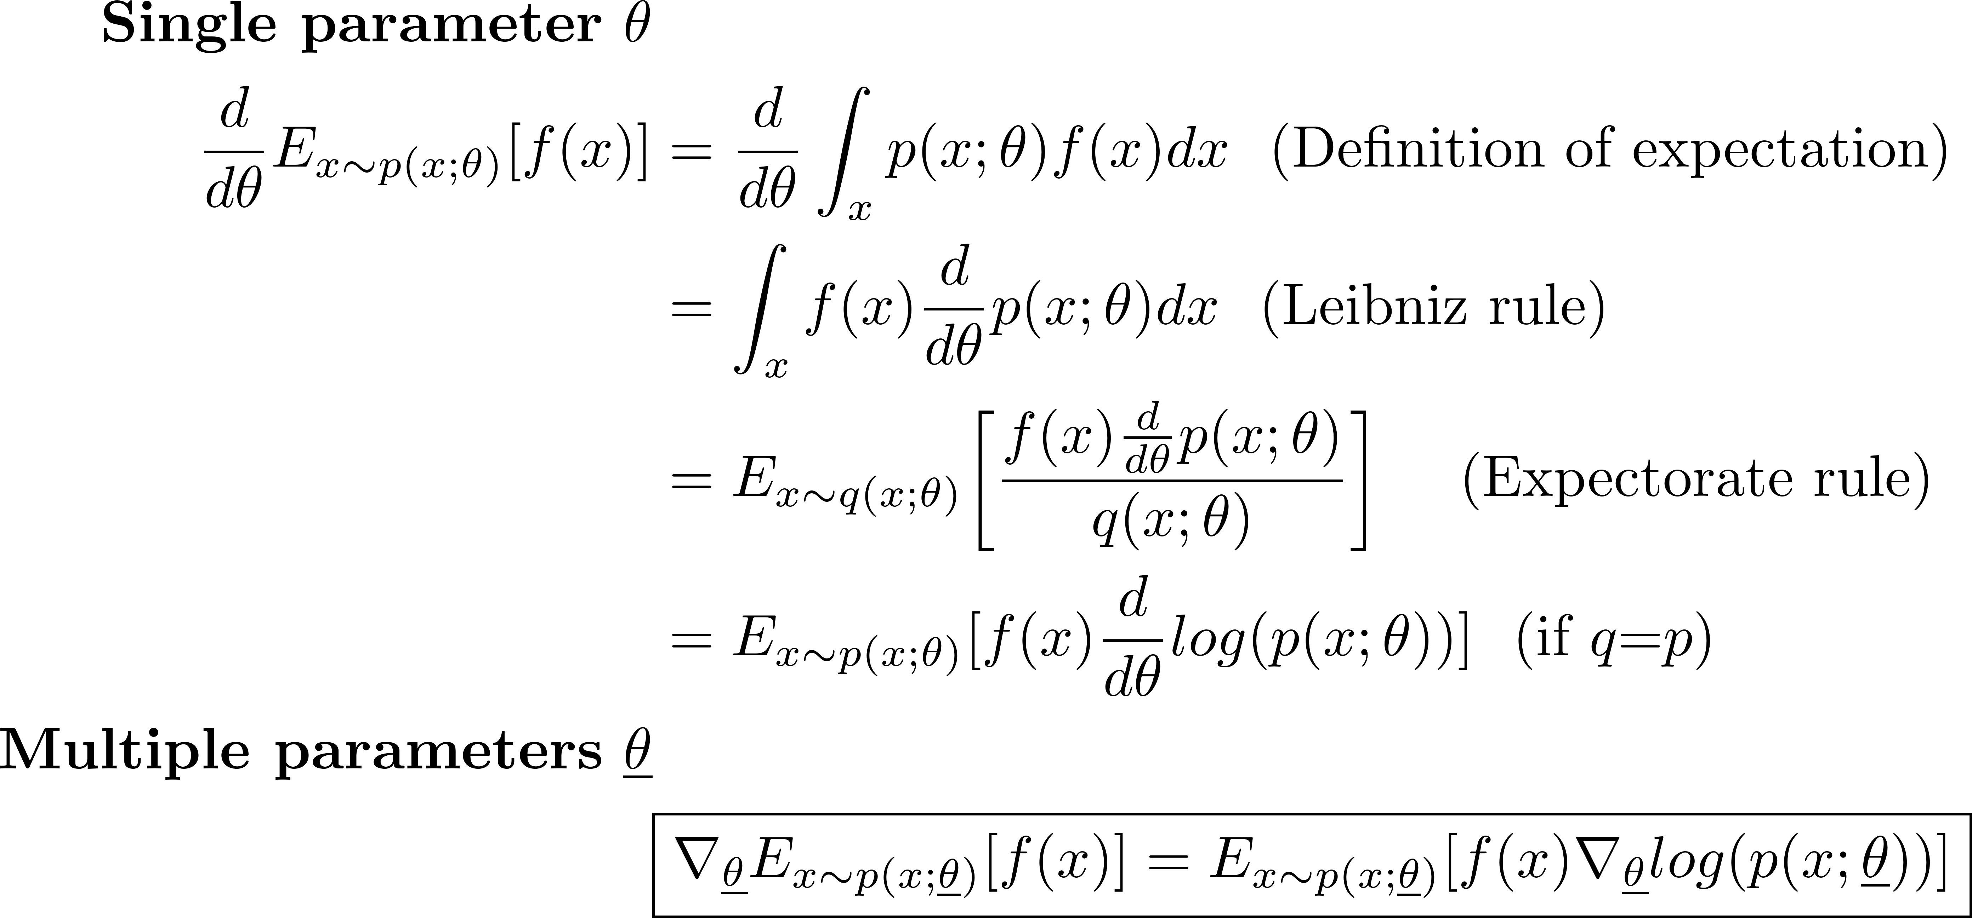
Log-derivative trick (II)
Rewrite derivative (gradient) of expectation as expectation so its value can be estimated w/Monte Carlo sampling
If we cannot evaluate integral analytically,
rewrite as expectation and use Monte Carlo sampling

Slide 9
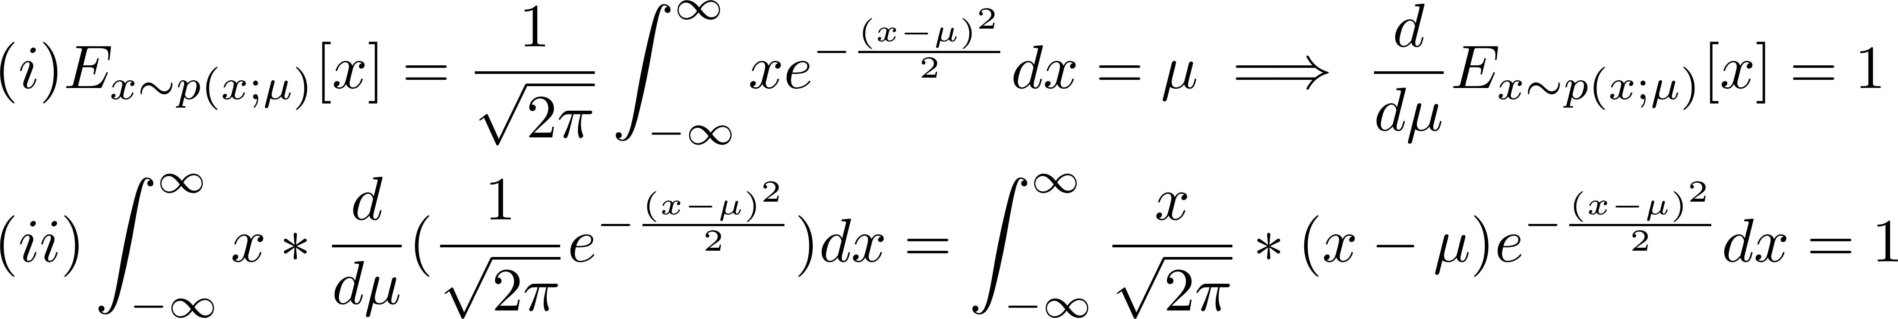
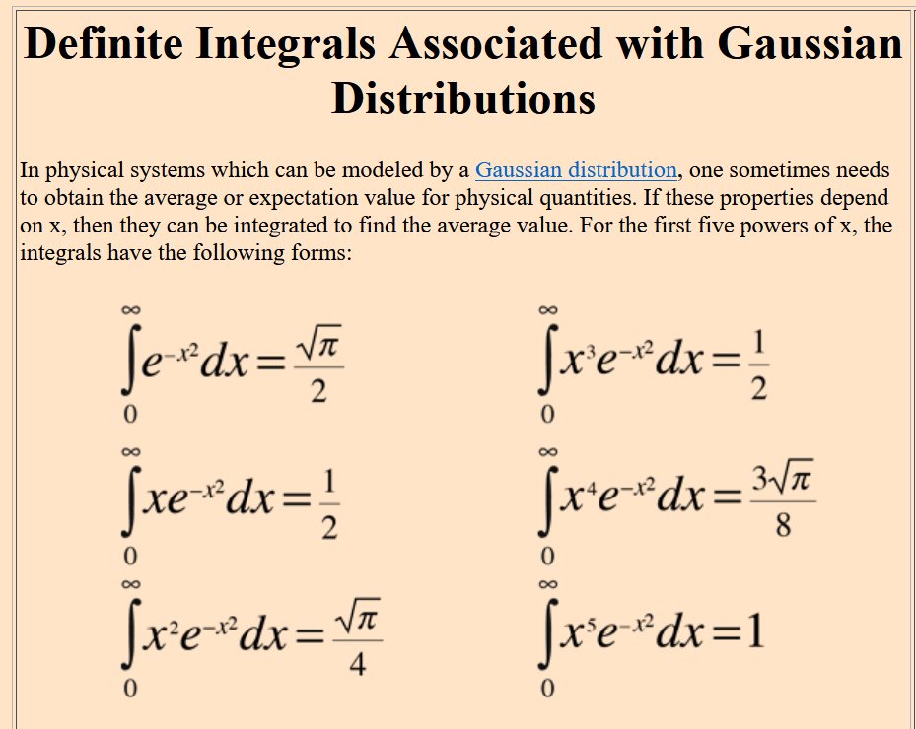
Check

Slide 10
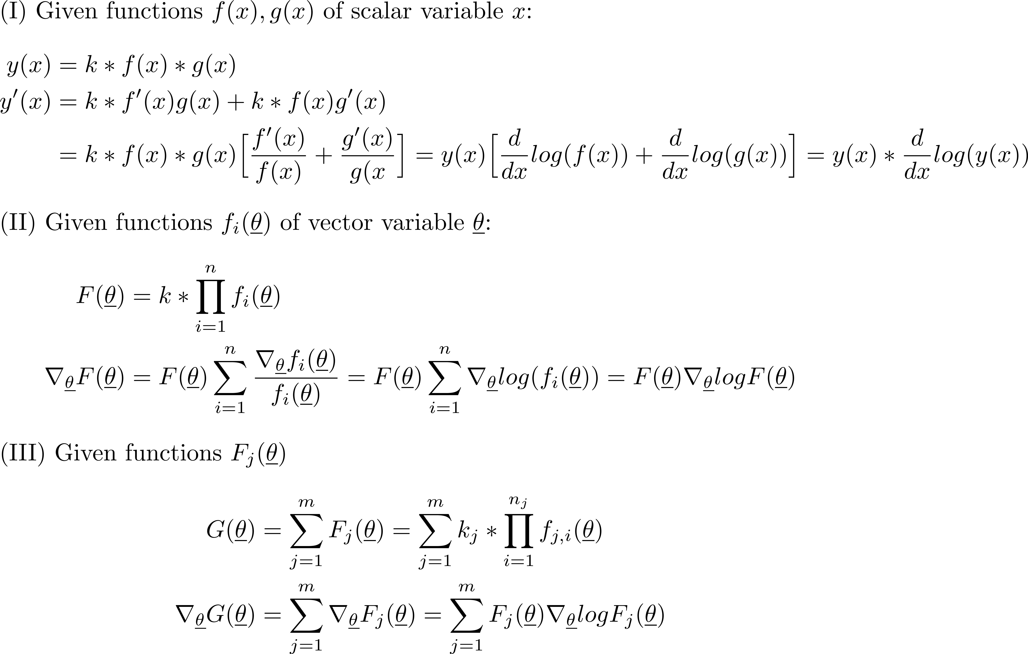
Log-derivative trick (Bologna presentation)
F_{j}
Sum of products
k_{j}
f_{j,i} (θ)
j
If G is expectation, gradient is expressed as expectation

Slide 11
Organization
Control
variates
Importance
sampling
Sample efficiency
by reducing variance
Unbiased
Monte Carlo integration w/ uniform sampling
Numerical integration:
forward-Euler, Simpson, ……
Estimation
Curse of dimensionality
Expectations
Log-derivative trick
Gradients of
expectations
Need
ML/RL

Slide 12
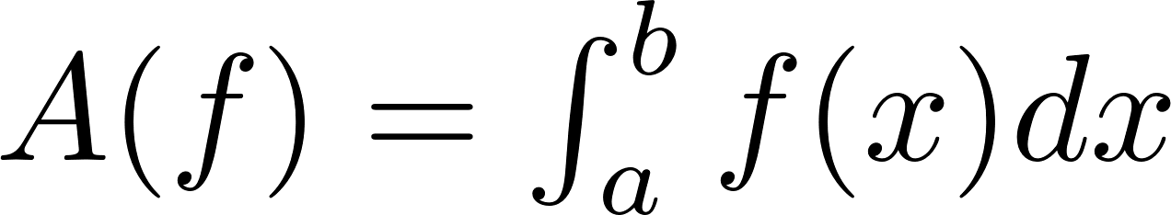
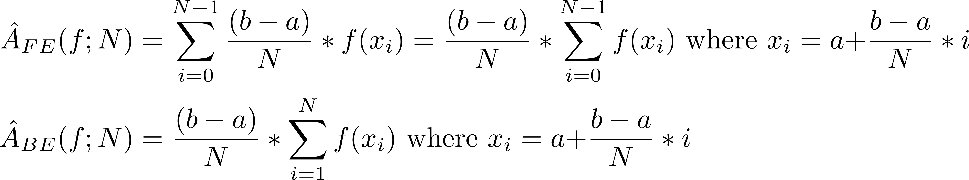
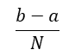
Numerical integration (I)
f(x)
x
a
x₁
x₂
x₃
b
$$\frac{b−a}{N}$$
Divide interval [a,b] into N intervals (usually fixed size)
Use a quadrature formula to estimate integral
Forward-Euler (FE), backward-Euler (BE), trapezoidal, Simpson’s rule,….

Slide 13
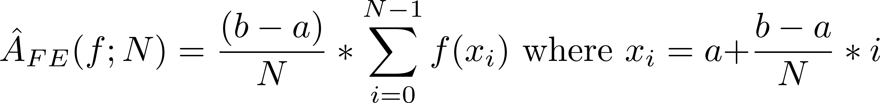
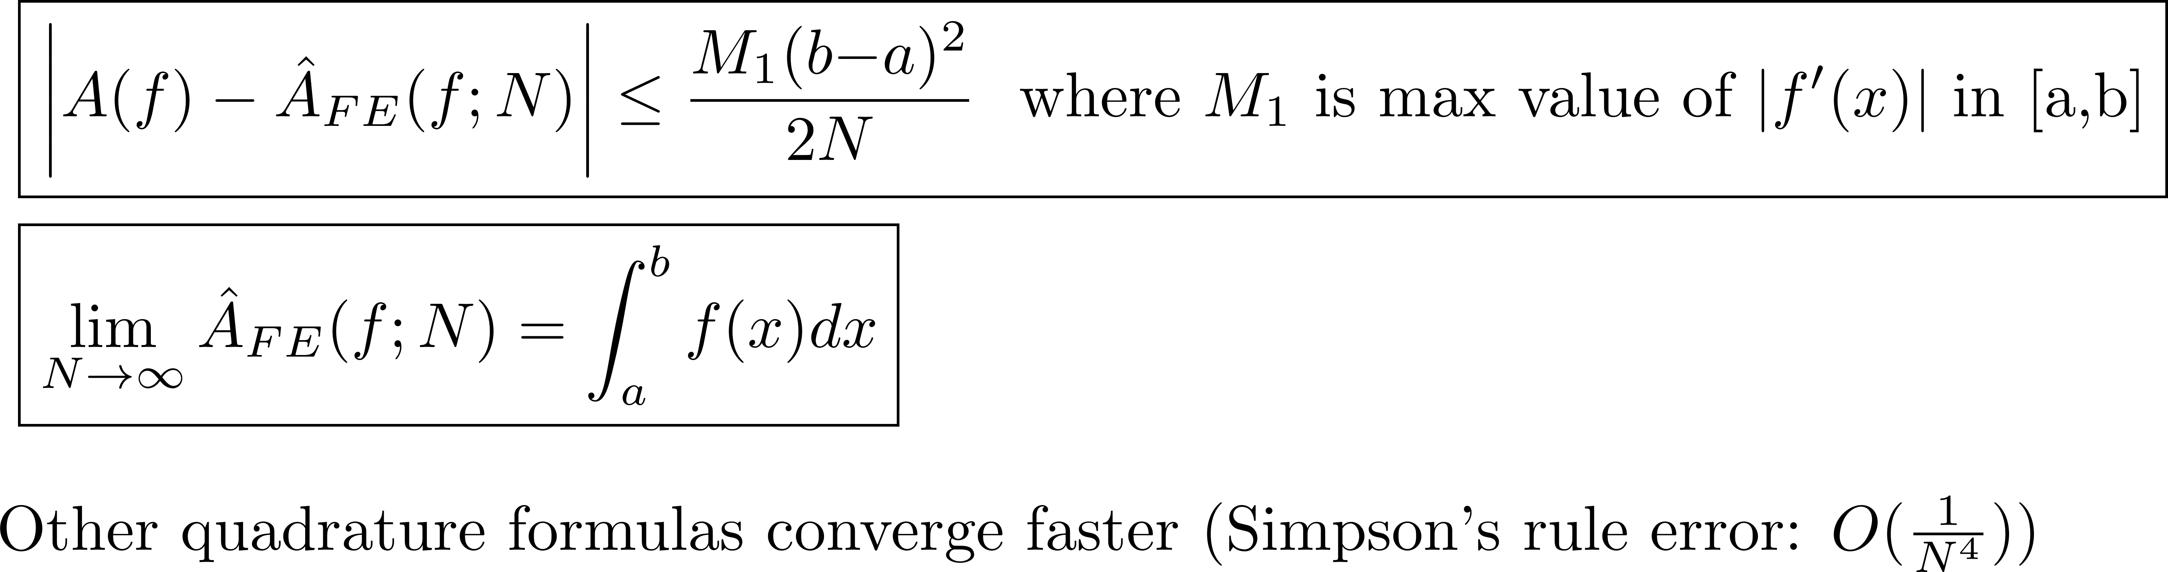
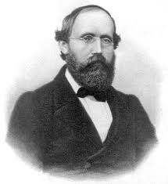
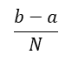
Convergence of forward-Euler
f(x)
x
a
x₁
x₂
x₃
b
$$\frac{b−a}{N}$$
Bernhard Riemann
(1826-1866)

Slide 14
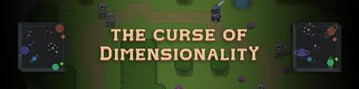
Drawback of numerical integration(II)
Works well in 1D and 2D
Curse of dimensionality: to achieve given accuracy, number of function evaluations grow as O(2^{d}) for d dimensions
Not used for high-dimensional integrals

Slide 15
Organization
Control
variates
Importance
sampling
Sample efficiency
by reducing variance
Unbiased
Monte Carlo integration w/ uniform sampling
Numerical integration:
forward-Euler, Simpson, ……
Estimation
Curse of dimensionality
Expectations
Log-derivative trick
Gradients of
expectations
Need
ML/RL

Slide 16
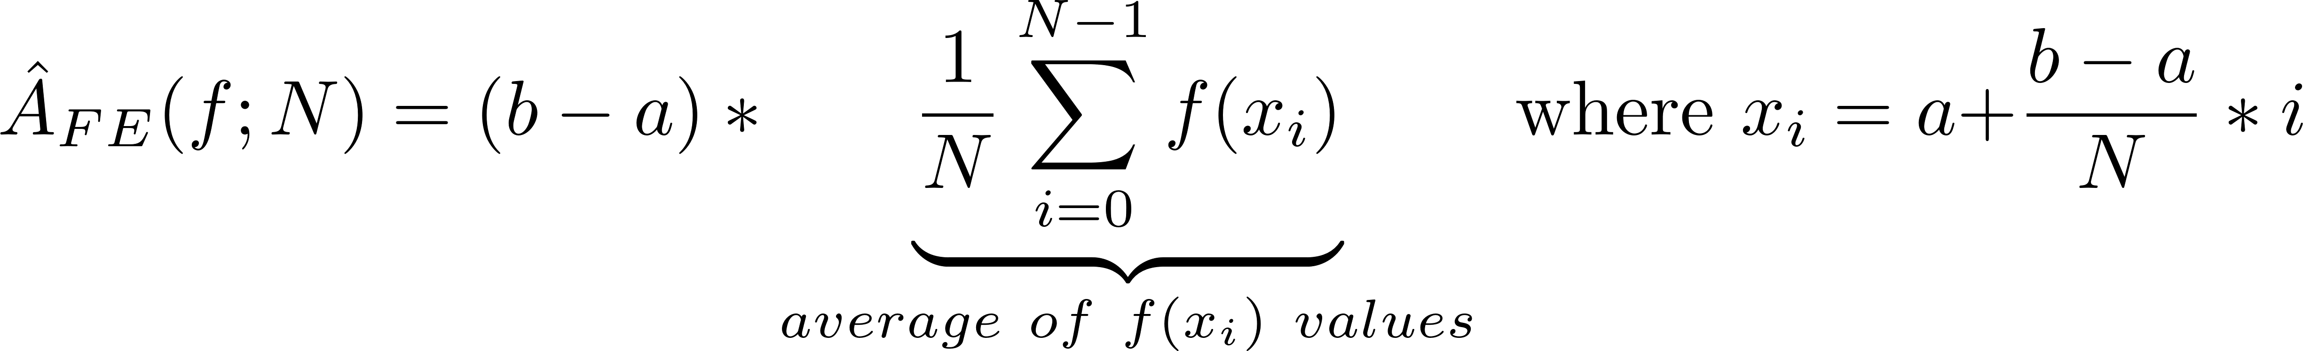
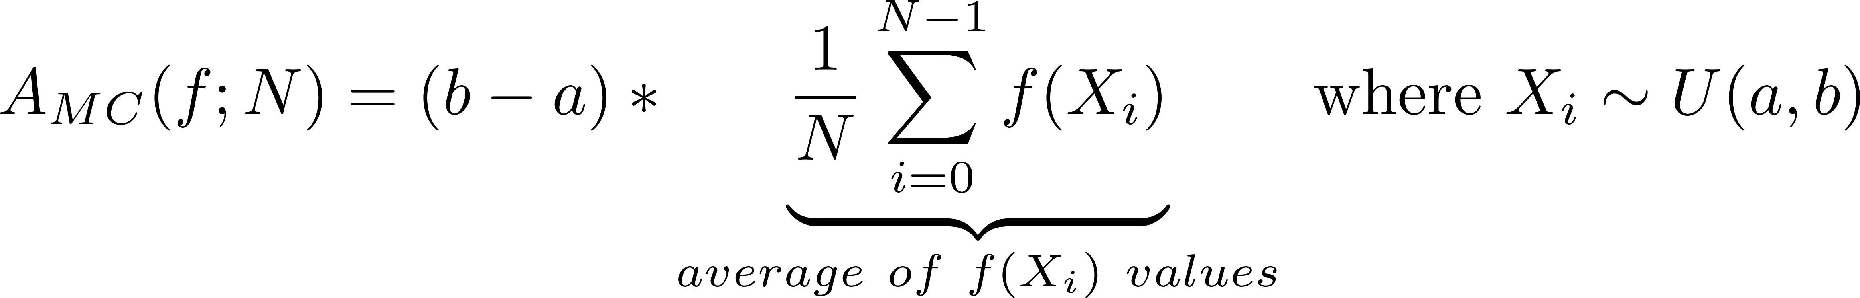
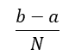
Monte Carlo integration w/uniform sampling
f(x)
f(x)
x
x₃
x
a
x₁
x₂
x₃
b
a
x₂
x₄
x₁
b
$$\frac{b−a}{N}$$
Reinterpret forward-Euler/backward-Euler
Generate x_{i} values using arithmetic progression
Take average of f(x_{i}) values and multiply by (b-a)
Monte Carlo integration (capital letters for random variables)
Generate X_{i} values by sampling uniform distribution U(a,b)
Take average of f(X_{i}) values and multiply by (b-a)

Slide 17
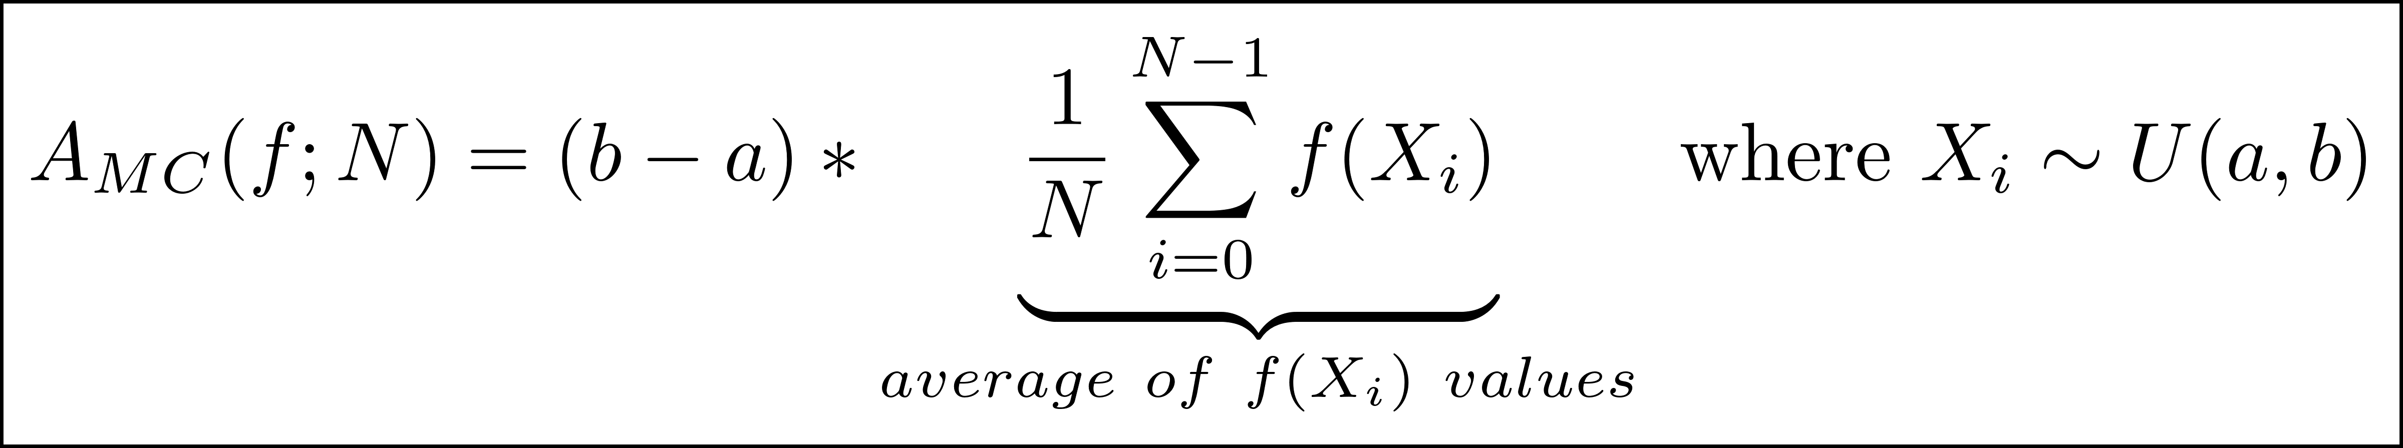
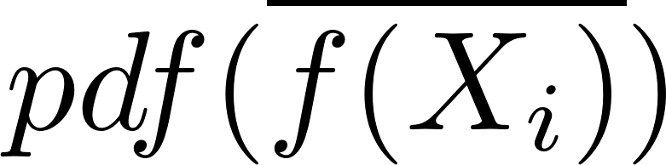
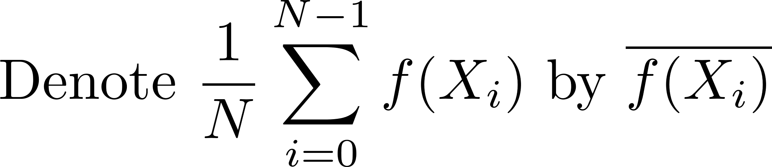
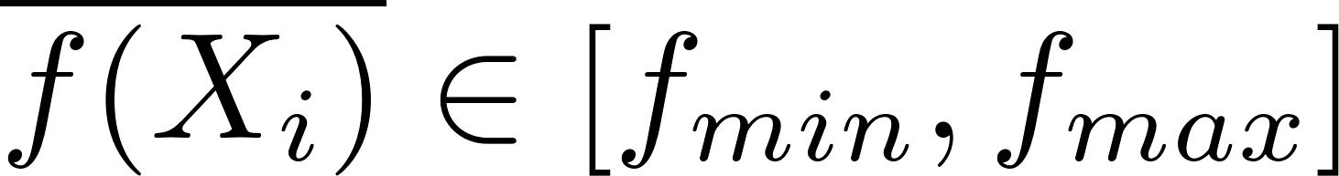
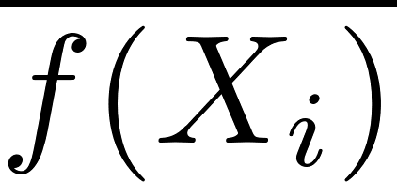
Correctness of Monte Carlo integration (I)
f(x)
f_{max}
f_{min}
X₃
x
a
X₂
X₄
X₁
b
X_{i}’s are independent identically distributed (i.i.d.) random variables
A_{MC}(f;N) is random variable
What does it mean for random variable to approximate area under curve?
Intuition
Let f_{min} and f_{max} be minimum and maximum value of f in interval [a,b]
N=100
N=20
N=1
f_{min}
f_{max}
https://www.scratchapixel.com/images/monte-carlo-methods/beanmachine.m4v

Slide 18
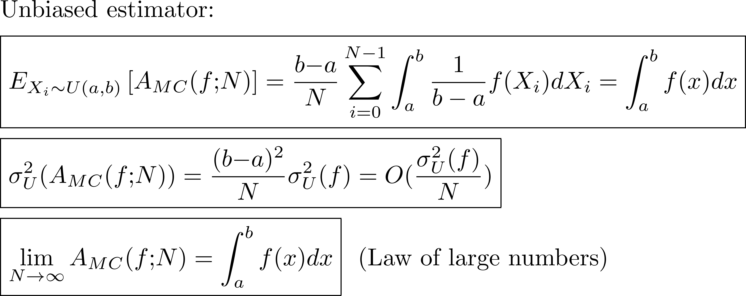
Correctness of Monte Carlo integration (II)
N=100
N=20
N=1
f_{min}
f_{max}
Convergence in probability

Slide 19
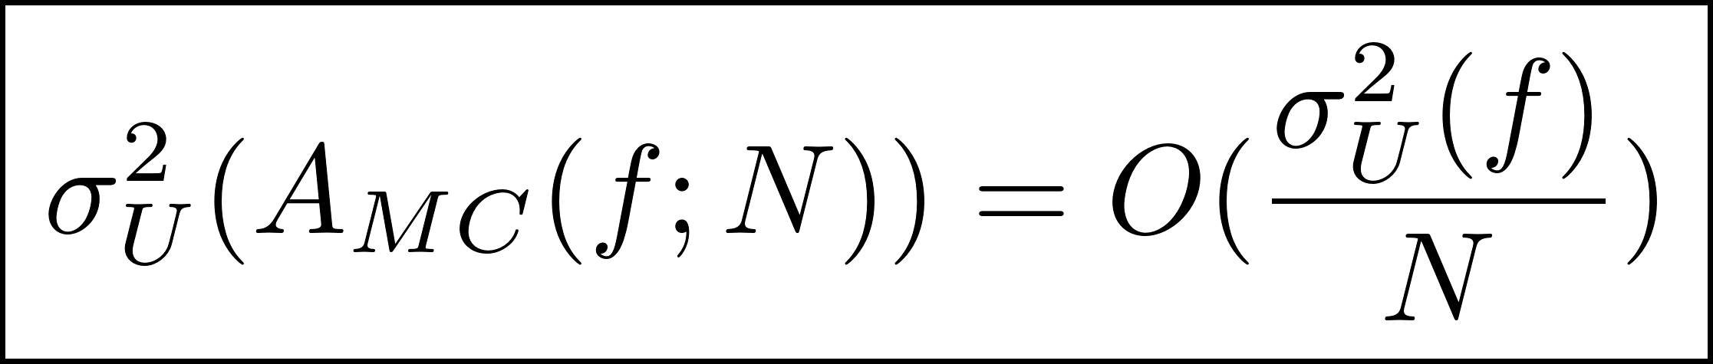
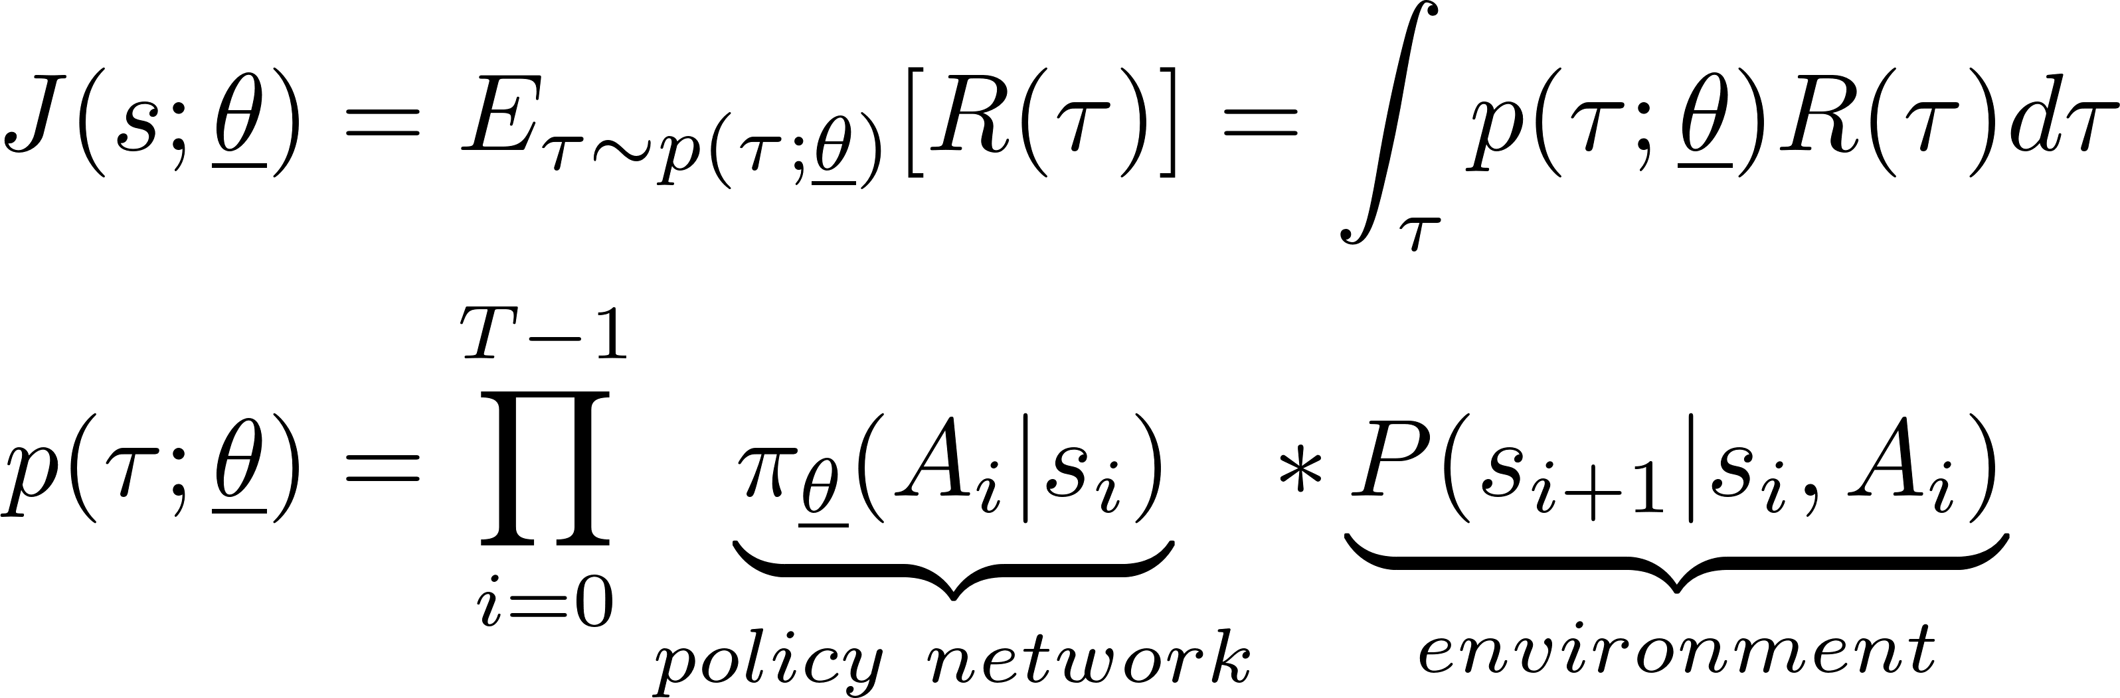
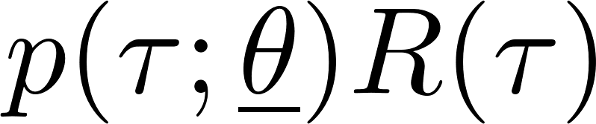
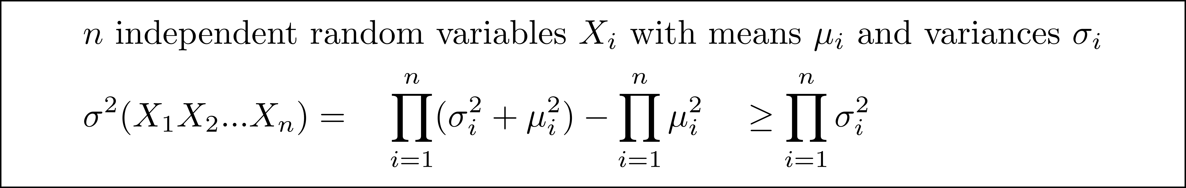
REINFORCE: Monte Carlo sampling for deep RL
τ
s₀
REINFORCE algorithm
Gradient ascent to optimize θ using Monte Carlo estimates
Sample trajectories out of s₀ to estimate ∇_{θ} J(s₀ ;θ)
Variance of can grow exponentially with number of steps (T) in trajectories

Slide 20
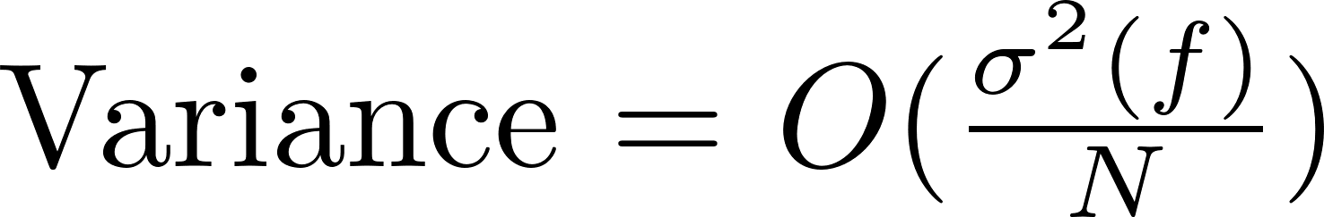
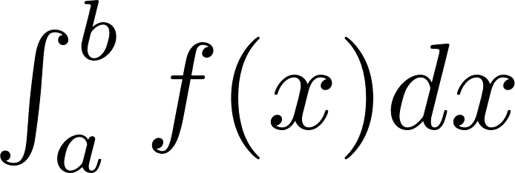
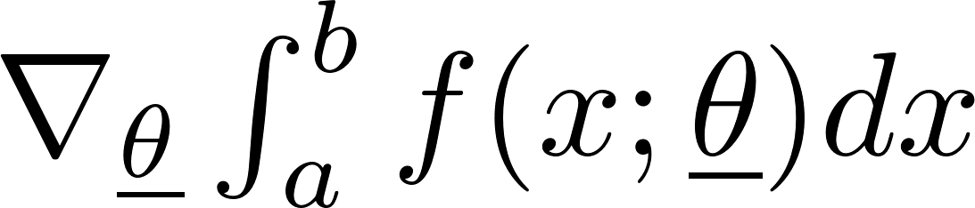
Organization
Control
variates
Importance
sampling
Sample efficiency
by reducing variance
Unbiased
Monte Carlo integration w/ uniform sampling
Numerical integration:
forward-Euler, Simpson, ……
Estimation
Curse of dimensionality
Expectations
Log-derivative trick
Gradients of
expectations
Need
ML/RL

Slide 21
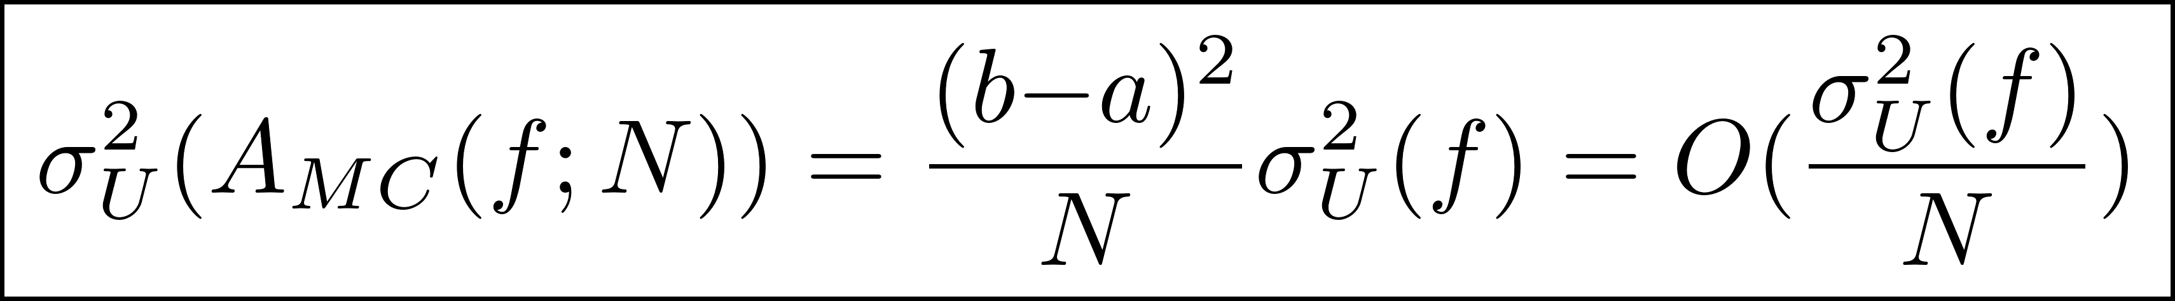
Reducing variance of Monte Carlo integration
Increase number of samples N
Expensive if obtaining samples is expensive
Stratified sampling: control distribution of samples
Random may not be best because of sample clumping (birthday paradox)
Change function being integrated (f) to another function (g)
If variance of g < variance of f, fewer samples needed
Calculate estimate for integral of f from estimate for integral of g
Many approaches
Importance sampling
Control variates
Antithetic variates
……

Slide 22
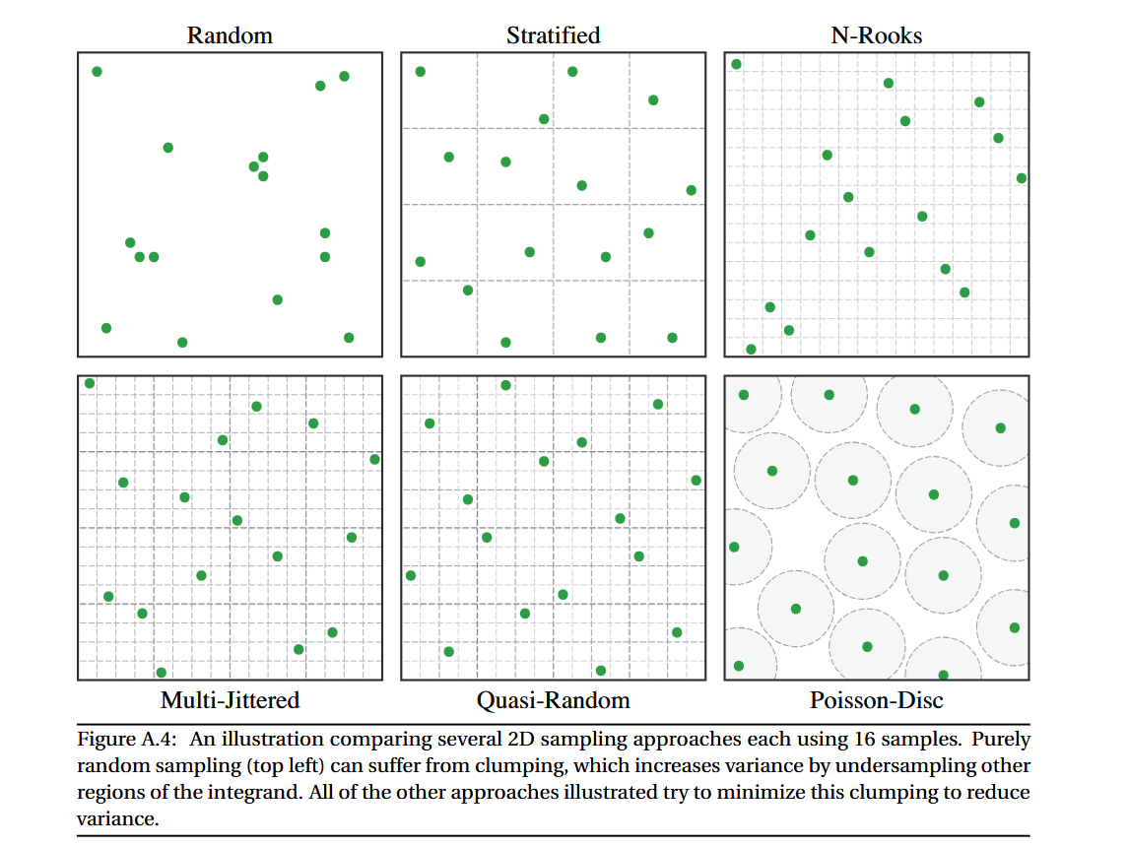
Reducing sample clumping by stratified sampling
Useful for spatial domains but perhaps not for policy spaces
https://cs.dartmouth.edu/~wjarosz/publications/dissertation/appendixA.pdf

Slide 23
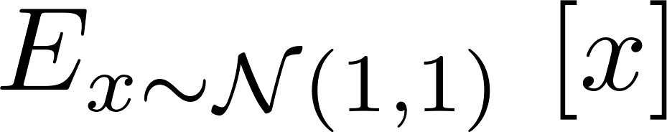
Importance sampling: intuitive idea
Expectation = area under purple curve
One possibility: uniform sampling in some large interval like [-1000,1000]
Most samples will contribute little to overall sum
Better idea: sample only in important regions where |h(x)| = |p(x)f(x)| >> 0
One possibility: uniform sampling in some interval like [-2,10]
Even better: skew samples from [-2,10] to positive x values
Even better: sample from distributions whose “shape” is close to that of |h(x)|

Slide 24
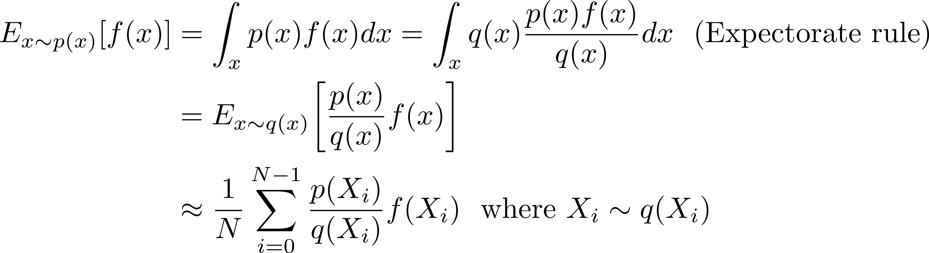
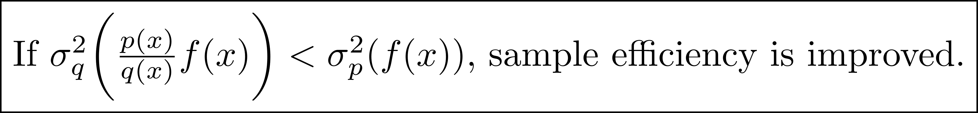
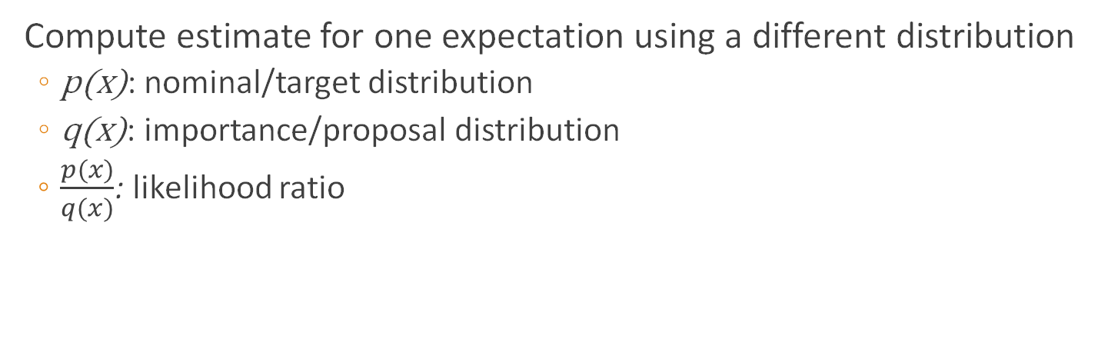
Importance sampling
Compute estimate for one expectation using a different distribution
p(x): nominal/target distribution
q(x): importance/proposal distribution
$\frac{p(x)}{q(x)}$: likelihood ratio

Slide 25
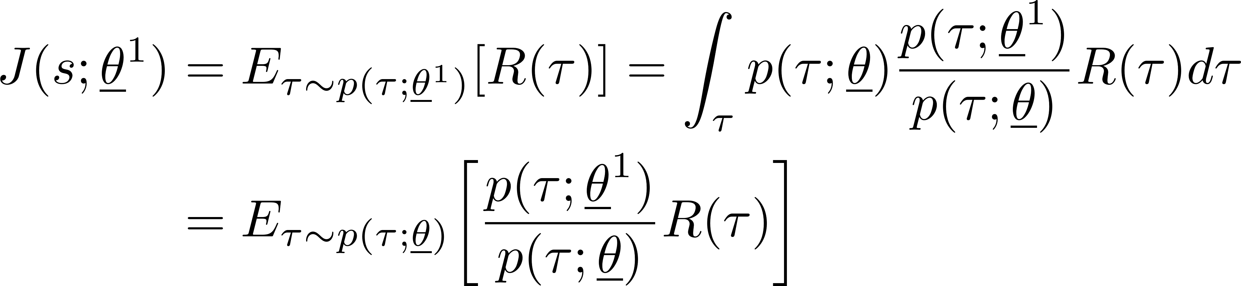
Importance sampling in deep RL
Application of expectorate rule (no notion of “importance”)
Improve sample efficiency by reusing samples when θ is updated to θ¹
Trajectories collected under θ are valid trajectories for θ¹ but transition probabilities will be different in general
If θ and θ¹ are close to each other, samples collected for θ will be representative for θ¹ well
Ensuring this in PPO/TRPO: clipping, KL-divergence check
τ
s₀
θ¹
θ
Gradient ascent in
parameter space

Slide 26

Control variates (intuition)
Example: poll to determine fraction of people in US who approve of Trump’s performance
One possibility: interview thousands of randomly chosen people to ensure representative sample (reduce variance)
Problem: expensive
Another possibility: smaller sample size to reduce cost
Problem: larger variance, so sample may not be representative
Idea: use smaller sample size but also ask people for party affiliation (control variate)
(i)We know fraction of country that is Republican (ii)Republicans are more likely to approve of Trump
If Republicans are
overrepresented in sample: reduce sample estimate of Trump approvers to obtain population estimate
underrepresented in sample: increase sample estimate
Easy to extend to more control variates

Slide 27
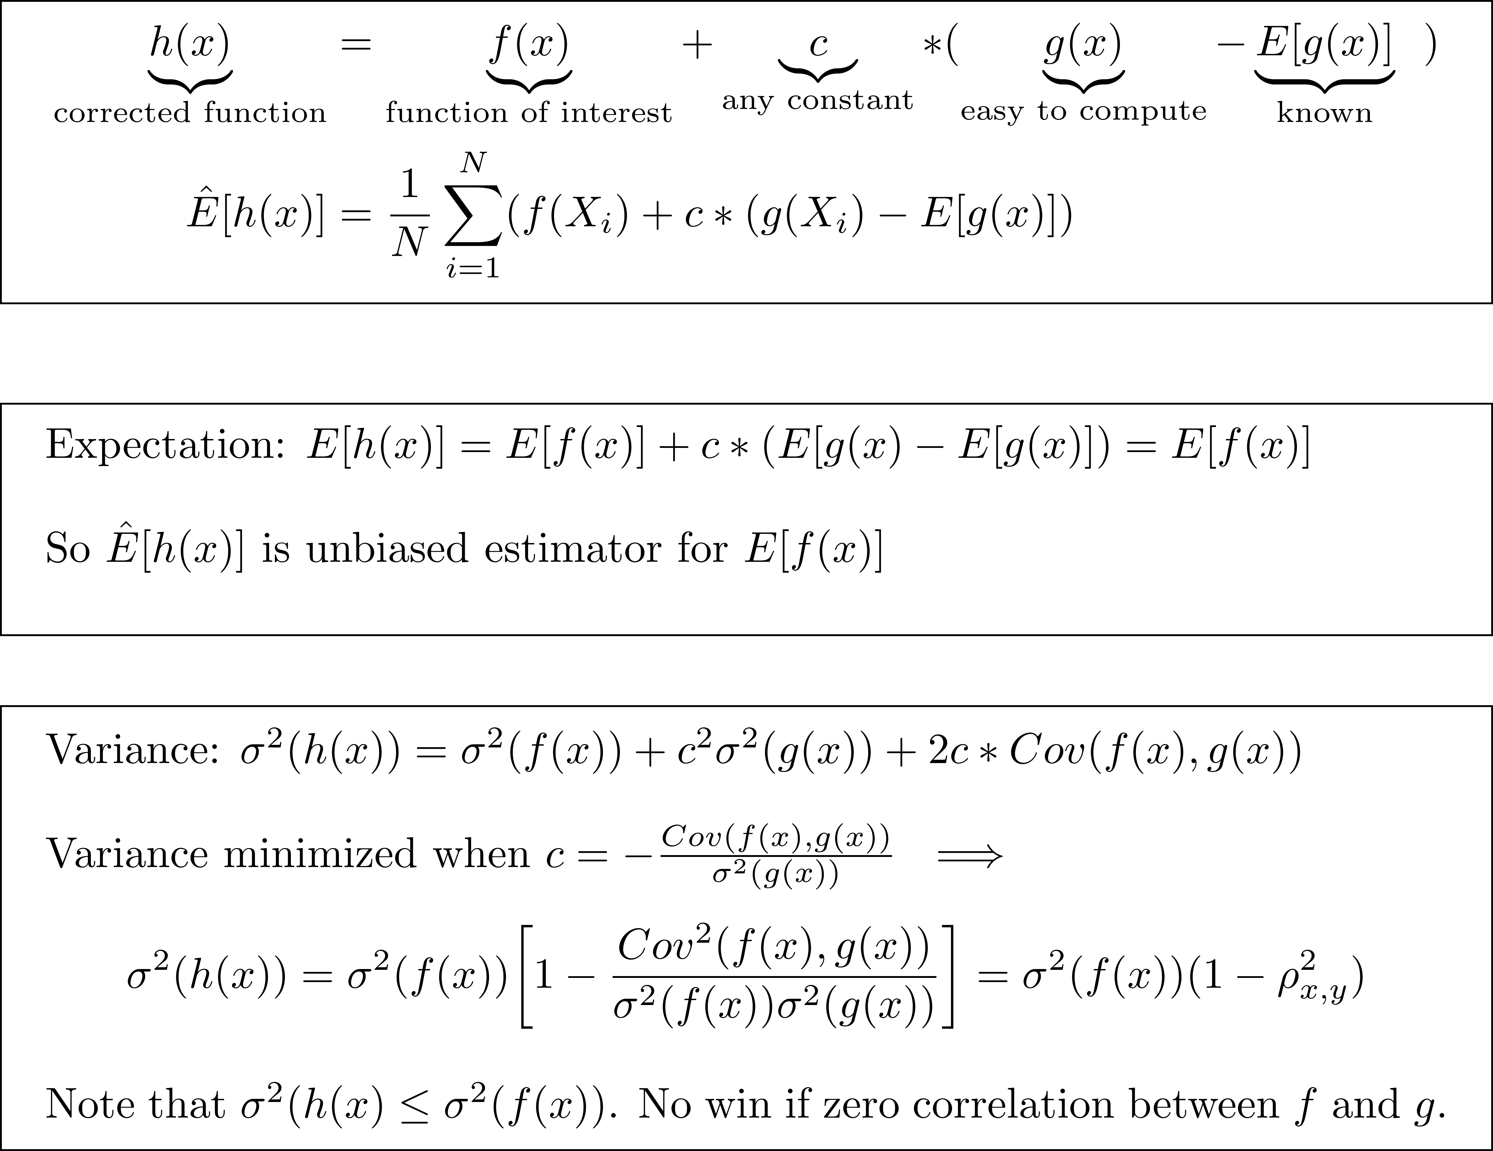
Control variates
Pearson’s correlation coefficient
-1 ≤ ρ_{x,y}≤ 1

Slide 28

Control variates example (from Wikipedia)
Exact value = ln 2 = 0.69314718
https://en.wikipedia.org/wiki/Control_variates

Slide 29

Control variates in RL

Slide 30
References
Well-written introduction to Monte Carlo integration and variance reduction
https://cs.dartmouth.edu/~wjarosz/publications/dissertation/appendixA.pdf
Using control variates for reducing variance in Monte Carlo rendering
https://cs.dartmouth.edu/~wjarosz/publications/rousselle16image.pdf

Slide 31

Correctness of Monte Carlo integration (II)
N=100
N=20
N=1
f_{min}
f_{max}

